Slide 1
Introduction
Building Personal Websites
Lecture 01 | Introduction

Slide 2
Logistics
Setting up GitHub Pages
Introduction to the HTML Structure
Building Personal Websites
Lecture 01 | Introduction

Slide 3
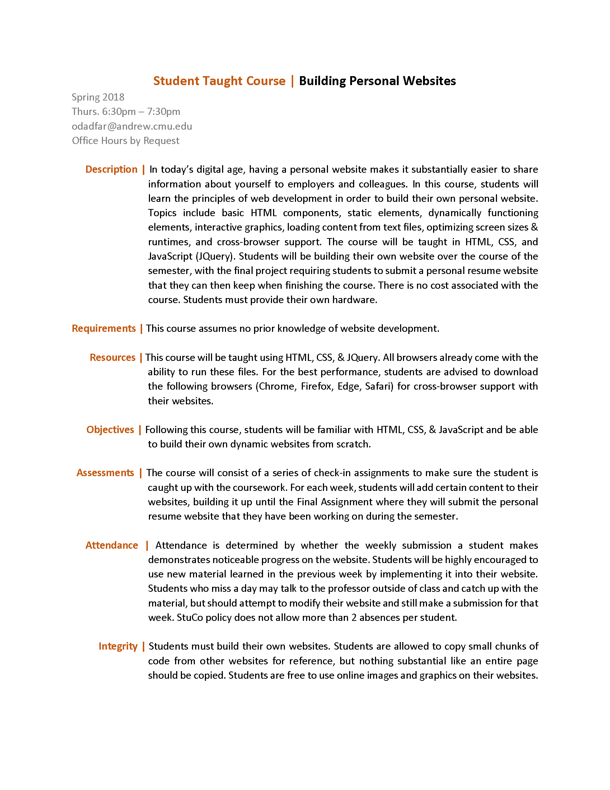
Syllabus Review
Building Personal Websites
Lecture 01 | Introduction

Slide 4
Main Points
This course assumes no prior knowledge of website development
Taught using HTML, CSS, & JQuery
Two Absences allowed by StuCo Policy
Short, fun polls to track attendance
Must provide own hardware
Each homework asks you to build upon your website with content from the most recent lecture
Lecture
Live Demo
Work Session
New Concepts
Examples
Ask Questions, Work on Site
Building Personal Websites
Lecture 01 | Introduction

Slide 5
Grading
Attendance
0 %
Paying Attention
0 %
Doing Homework
0 %
Reviewing Slides & Notes
0 %
Asking Meaningful Questions
0 %
Being Proud of the Site You Build
10000000000000000000000000000000000000000000000000000000000000000000000000000000000000000000000000000000000000000000000000 %
* To qualify for this, you must attend all but 2 lectures and commit updates to your site for all but 2 weeks
Building Personal Websites
Lecture 01 | Introduction

Slide 6
Goals
To develop a personal website (resume, portfolio, etc.)
Commit changes each week to GitHub Pages
Building Personal Websites
Lecture 01 | Introduction

Slide 7
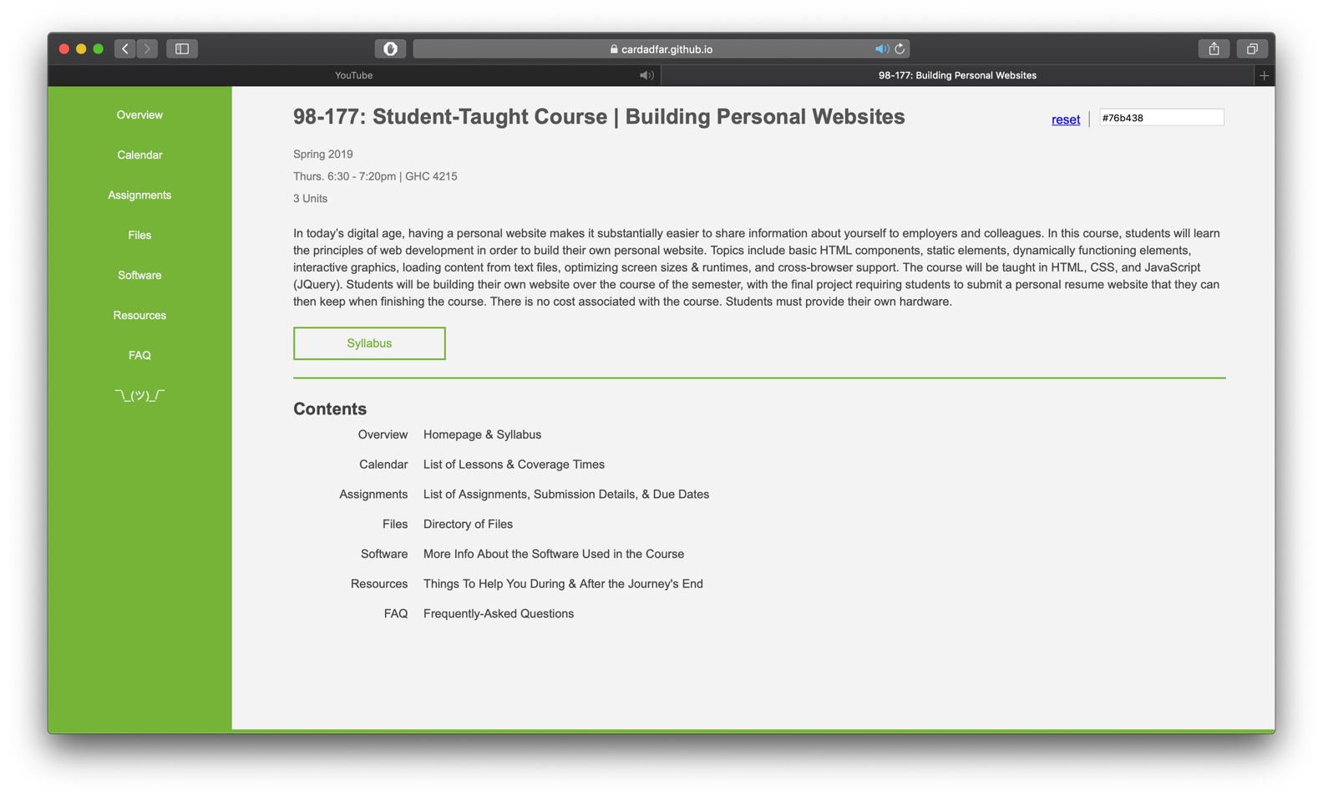
Course Webpage
https://tinyurl.com/stuco-bpw
* bookmark this *
Building Personal Websites
Lecture 01 | Introduction

Slide 8
Building Personal Websites
Lecture 01 | Introduction

Slide 9
What You Will Need
Browsers (To test on different platforms)
Chrome
Safari (Mac only)
Edge
Firefox (People still use this)
Text Editors
Sublime
Notepad (For the brave)
Software
HTML & CSS (Integrated in browsers)
JQuery (Will discuss later)
WEAN & CFA Clusters have iMacs with Safari
Building Personal Websites
Lecture 01 | Introduction

Slide 10
Logistics
Setting up GitHub Pages
Introduction to the HTML Structure
Building Personal Websites
Lecture 01 | Introduction

Slide 11
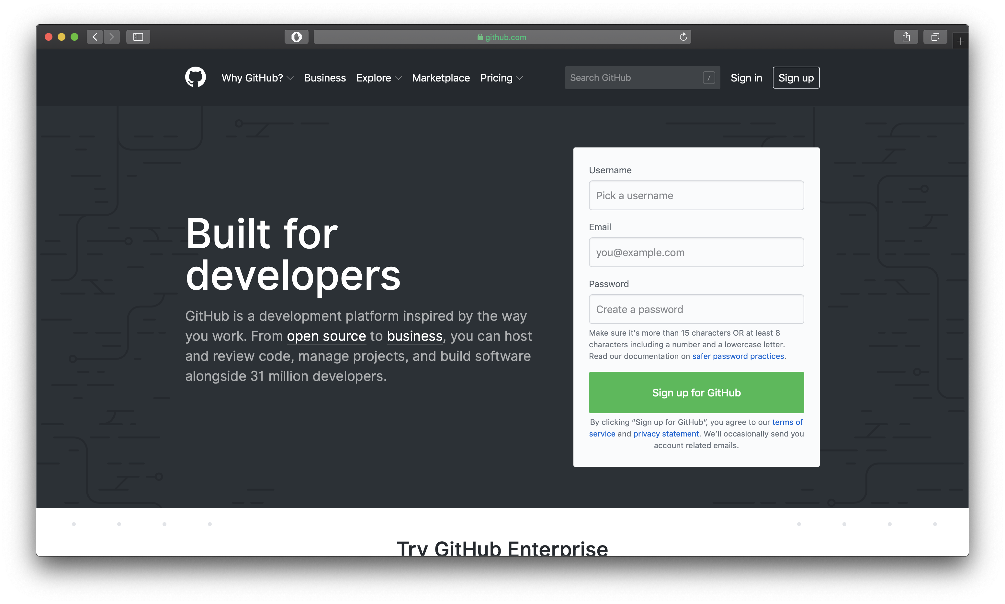
Create a free GitHub account
Building Personal Websites
Lecture 01 | Introduction

Slide 12
Create a live page for your site
Upload files from your computer
Building Personal Websites
Lecture 01 | Introduction

Slide 13
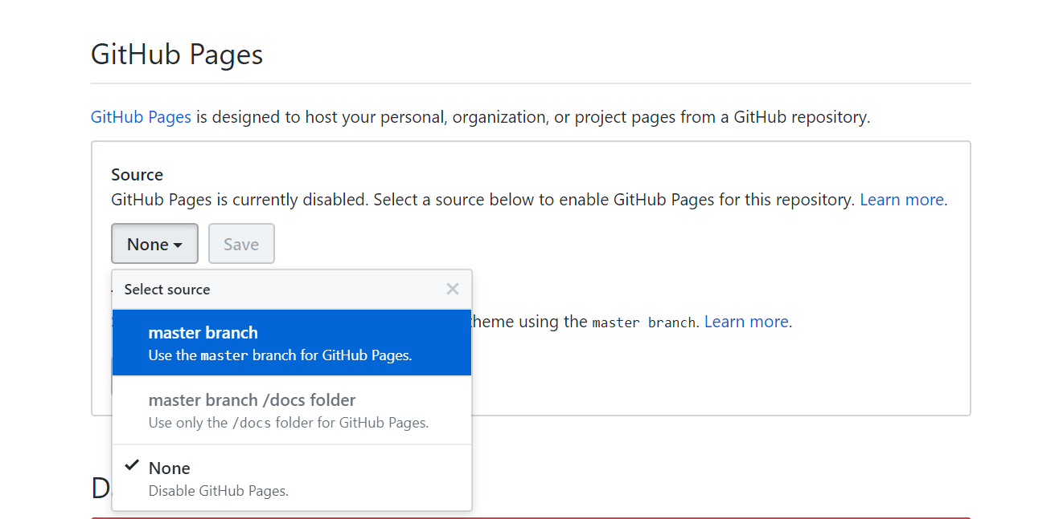
Make sure to have an index.html file as the homepage.
This is what GitHub Pages looks for to start at.
Building Personal Websites
Lecture 01 | Introduction

Slide 14
Clone repository to a local directory.
Any changes you make to that directory can be uploaded back to GitHub.
Building Personal Websites
Lecture 01 | Introduction

Slide 15
Pushing Changes to GitHub
Add files to a queue ready to be pushed
git add ‘filename’
To add all files in current directory
git add .
Add a commit message (good place to mention what you’ve changed)
git commit -m ‘public commit message’
Push changes
git push
Building Personal Websites
Lecture 01 | Introduction

Slide 16
Logistics
Setting up GitHub Pages
Introduction to the HTML Structure
Building Personal Websites
Lecture 01 | Introduction

Slide 17
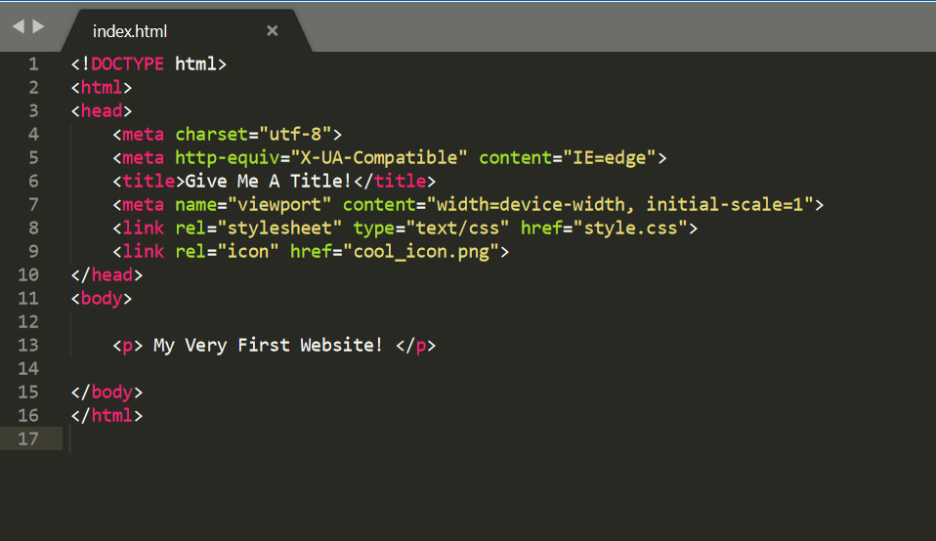
source | html_starter.html
Building Personal Websites
Lecture 01 | Introduction

Slide 18
HTML comes in Tag:Content pairs
< tag content=“content” >
< tag > content </ tag >
The type of tag dictates what form it is
source | html_starter.html
Building Personal Websites
Lecture 01 | Introduction

Slide 19
< html >
< head >
< meta … >
< title > …. </ title >
< link … >
</ head >
< body >
< p > … </ p >
</ body >
</ html >
source | html_starter.html
Building Personal Websites
Lecture 01 | Introduction

Slide 20
Live Demo
Building Personal Websites
Lecture 01 | Introduction

